Slide 1

Heart Disease Detection Using Machine Learning in R
Aaron Carr
Daniel Reardon
← Click the audio symbols for our narration

Slide 2
Introduction
Heart Disease is the number one leading cause of death globally, with over 17 million deaths per year (31% of all deaths)
4/5 of all heart disease deaths are due to sudden events such as heart attacks and strokes, and ⅓ are occur to people under the age of 70
A statistical model which is capable of accurately predicting a high risk for heart disease has the potential to flag people for preventative care, potentially saving many lives
Many of the markers of heart disease are easily detectable, and datasets which include these are easy to find
Our goal is to build a model which is able to detect the presence of heart disease as consistently as possible

Slide 3
Dataset
918 observations of 12 attributes - consisting of 5 separate datasets from Long Beach California, Hungary, Switzerland, Cleveland, and the Stalog Heart Dataset
Attributes include:
Sex
Age
Type of Chest Pain
Resting Blood Pressure
Cholesterol
Fasting Blood Sugar
Resting Electrocardiogram Results
Maximum Heart Rate
Exercise Induced Angina (Chest Pain)
Oldpeak
ST Slope
Heart Disease
(Angina is a type of chest pain, Oldpeak and ST slope refer to specific features of electrocardiogram results)

Slide 4

Data Wrangling
Dataset originally consisted of 12 attributes, some of which were categorical and consisted of 3 or more possible values
In order to make these attributes usable by the models, we needed to split these categories into binary categories, which we performed using a dplyr pipeline
While the dataset did not have any null values, many of the Cholesterol attribute values were listed as a zero, which clearly is erroneous
We constructed a toy linear regression model to predict the values of the cholesterol attribute for the entries which appeared to be erroneous

Slide 5
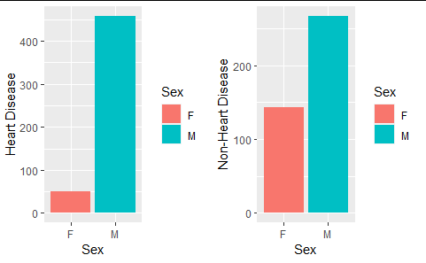
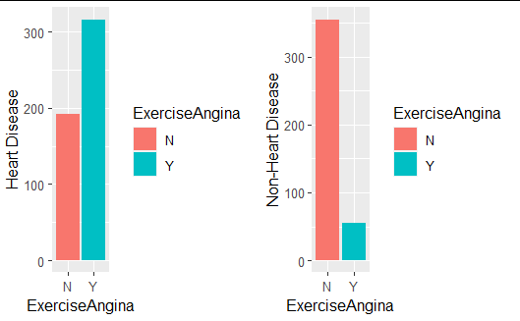
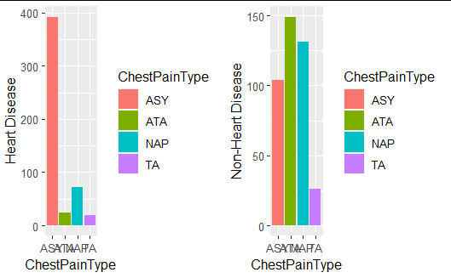
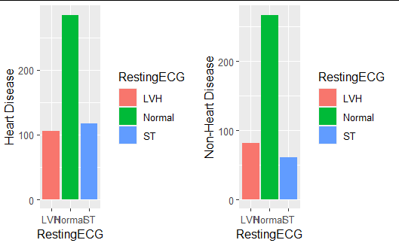
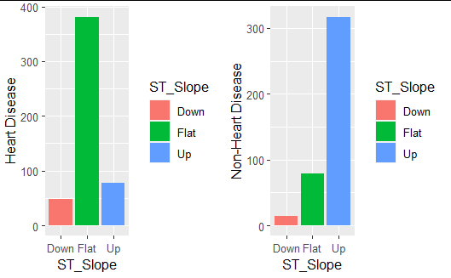
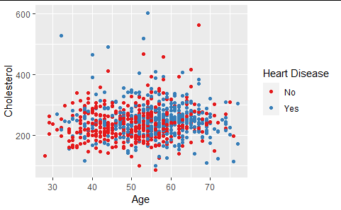
Data Visualization

Slide 6
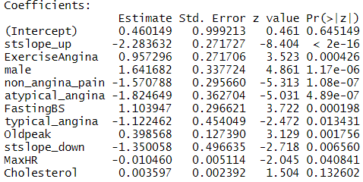
The Model

Slide 7
The Model cont.
The model is a logistic regression model. It returns a probability of the outcome variable given values for the variables.
For example, the estimate for the sex of the patient is 1.642. Meaning that a male has e^{1.642} higher odds (or about 5 times higher odds) of having heart disease than a female.
The algorithm used to select the features used in the model was the stepwise regression algorithm. The algorithm begins with nothing in the model but the intercept, and adds the most significant variable. It continues this step until there are no more significant variables. However, at each step it also looks to see that no variables have been made insignificant by the addition of new variables.

Slide 8
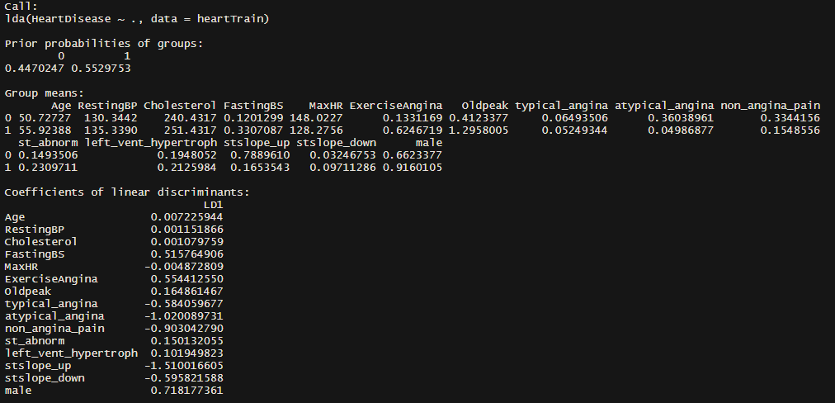
Other Attempted Models: Linear Discriminant Analysis
A basic linear discriminant analysis had an accuracy approaching that of the logistic regression model, of about 87%

Slide 9
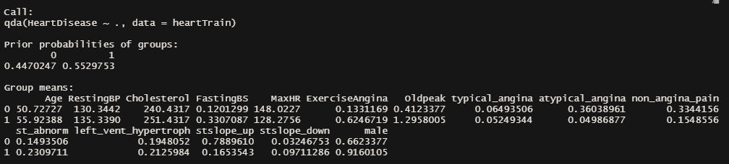
Other Attempted Models: Quadratic Discriminant Analysis
The quadratic discriminant model only reached about 85% accuracy, slightly worse than the either logistic regression or linear discriminant
Might be indicative of the the decision boundary being roughly linear in shape

Slide 10
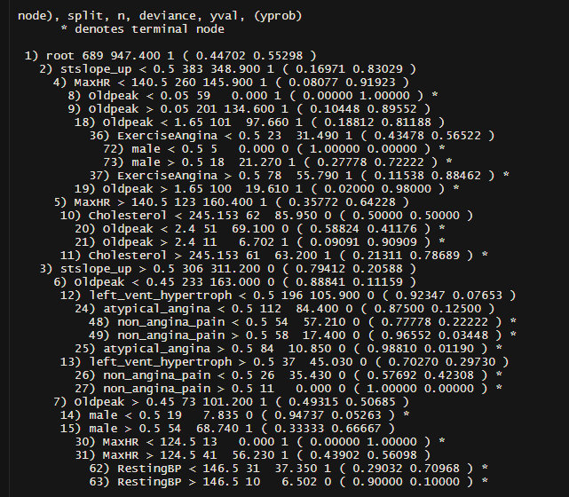
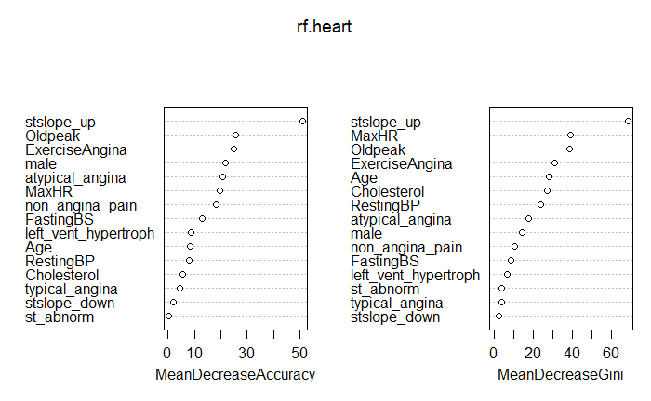
Other Attempted Models: Decision Tree and Random Forest
A single decision tree ended up only having an accuracy of 82%
The random forest method, however, was much more accurate, approaching 87% accuracy
The random forest method also found that the the presence of “ST Slope Up” to be by far the most important variable for predicting the absence of heart disease, in agreement with the logistic regression model

Slide 11
Summary
In summary, we have decided that the logistic model is the best model to use to solve this problem. It performs at or above the level of the other methods we tried, but it has the added benefit of being the easiest model to understand for someone who is not statistically literate.

Slide 12
Citations
fedesoriano. (September 2021). Heart Failure Prediction Dataset. Retrieved 4/17/2022 from https://www.kaggle.com/fedesoriano/heart-failure-prediction.

